Slide 1
An illustrated introduction to the Classical Language Toolkit & Archive
Arts and Humanities Research Computing
Harvard University
October 26, 2016
Luke Hollis & Kyle P. Johnson
luke@archimedes.digital, kyle@kyle-p-johnson.com

Slide 2
About the Toolkit and Archive

Slide 3
The CLTK’s goals …
Low: Good datasets for NLP of ancient languages (Egyptian hieroglyphs, Ancient Greek, Latin, Hebrew, Sanskrit, Tibetan, Classical Chinese, etc.)

Slide 4
The CLTK’s goals …
Low: Good datasets for NLP of ancient languages (Egyptian hieroglyphs, Ancient Greek, Latin, Hebrew, Sanskrit, Tibetan, Classical Chinese, etc.)
Medium: Quantified Classics

Slide 5
The CLTK’s goals …
Low: Good datasets for NLP of ancient languages (Egyptian hieroglyphs, Ancient Greek, Latin, Hebrew, Sanskrit, Tibetan, Classical Chinese, etc.)
Medium: Quantified Classics
High: Framework for an integrated study of the ancient world

Slide 6
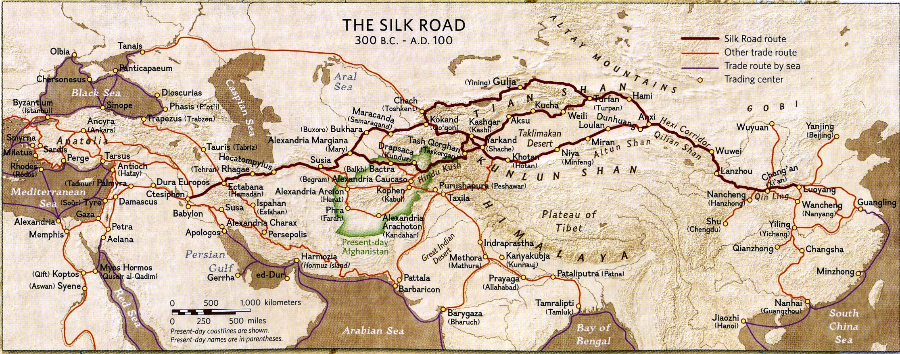
… for a connected ancient world
Notes:
https://s-media-cache-ak0.pinimg.com/originals/61/b2/34/61b23411d0990a69b32a89fba0536cd3.jpg

Slide 7

By the numbers
Began 2014
1,660 commits
33 contributors
32 watchers, 136 stars, 98 forks
47 people, 18 teams
33 releases (with DOI for every release)
84% code coverage
Full POSIX support
2 students, Google Summer of Code
Patrick Burns, PhD (ISAW)
Suhaib Khan (Netaji Subhas Institute of Technology, Delhi, India); mentored by Luke Hollis of Archimedes Digital)

Slide 8
Some basic terms
Python: A programming language known for its easy-to-read syntax and general friendliness
NLP: Natural language processing
Package or “library”: Collection of software for a particular set of tasks
NLTK: A prominent NLP package for the Python language
Git: Software for distributed software development
GitHub: A website which makes Git easy
Jupyter (formerly IPython): “Scientific notebooks”, an easy way to share code

Slide 9
Design principles
Disintermediation
Independent of academic bureaucracy
Software direct into researchers’ hands
Decentralization
Distributed by Git
Not “pet project” of one person – of many!
Transparency
Public development on GitHub
Public, readable code
Standardization
Scientific reproducibility
Good basic texts, but editable

Slide 10
Design principles
Extensibility
Accepting of any proven NLP algorithms
100% NLP coverage of all ancient langs
Multi–disciplinary
Academic depts, CS, faith traditions
Intersection of industry & academe
Mutual benefit
Full public record of all commits
Researchers develop own work
Inclusion
Collaborative, encouraging
Free, easy communication

Slide 11
Design principles
Free & open source
Fork, modify, merge … whatever!
MIT licence (OK for commercial use)

Slide 12
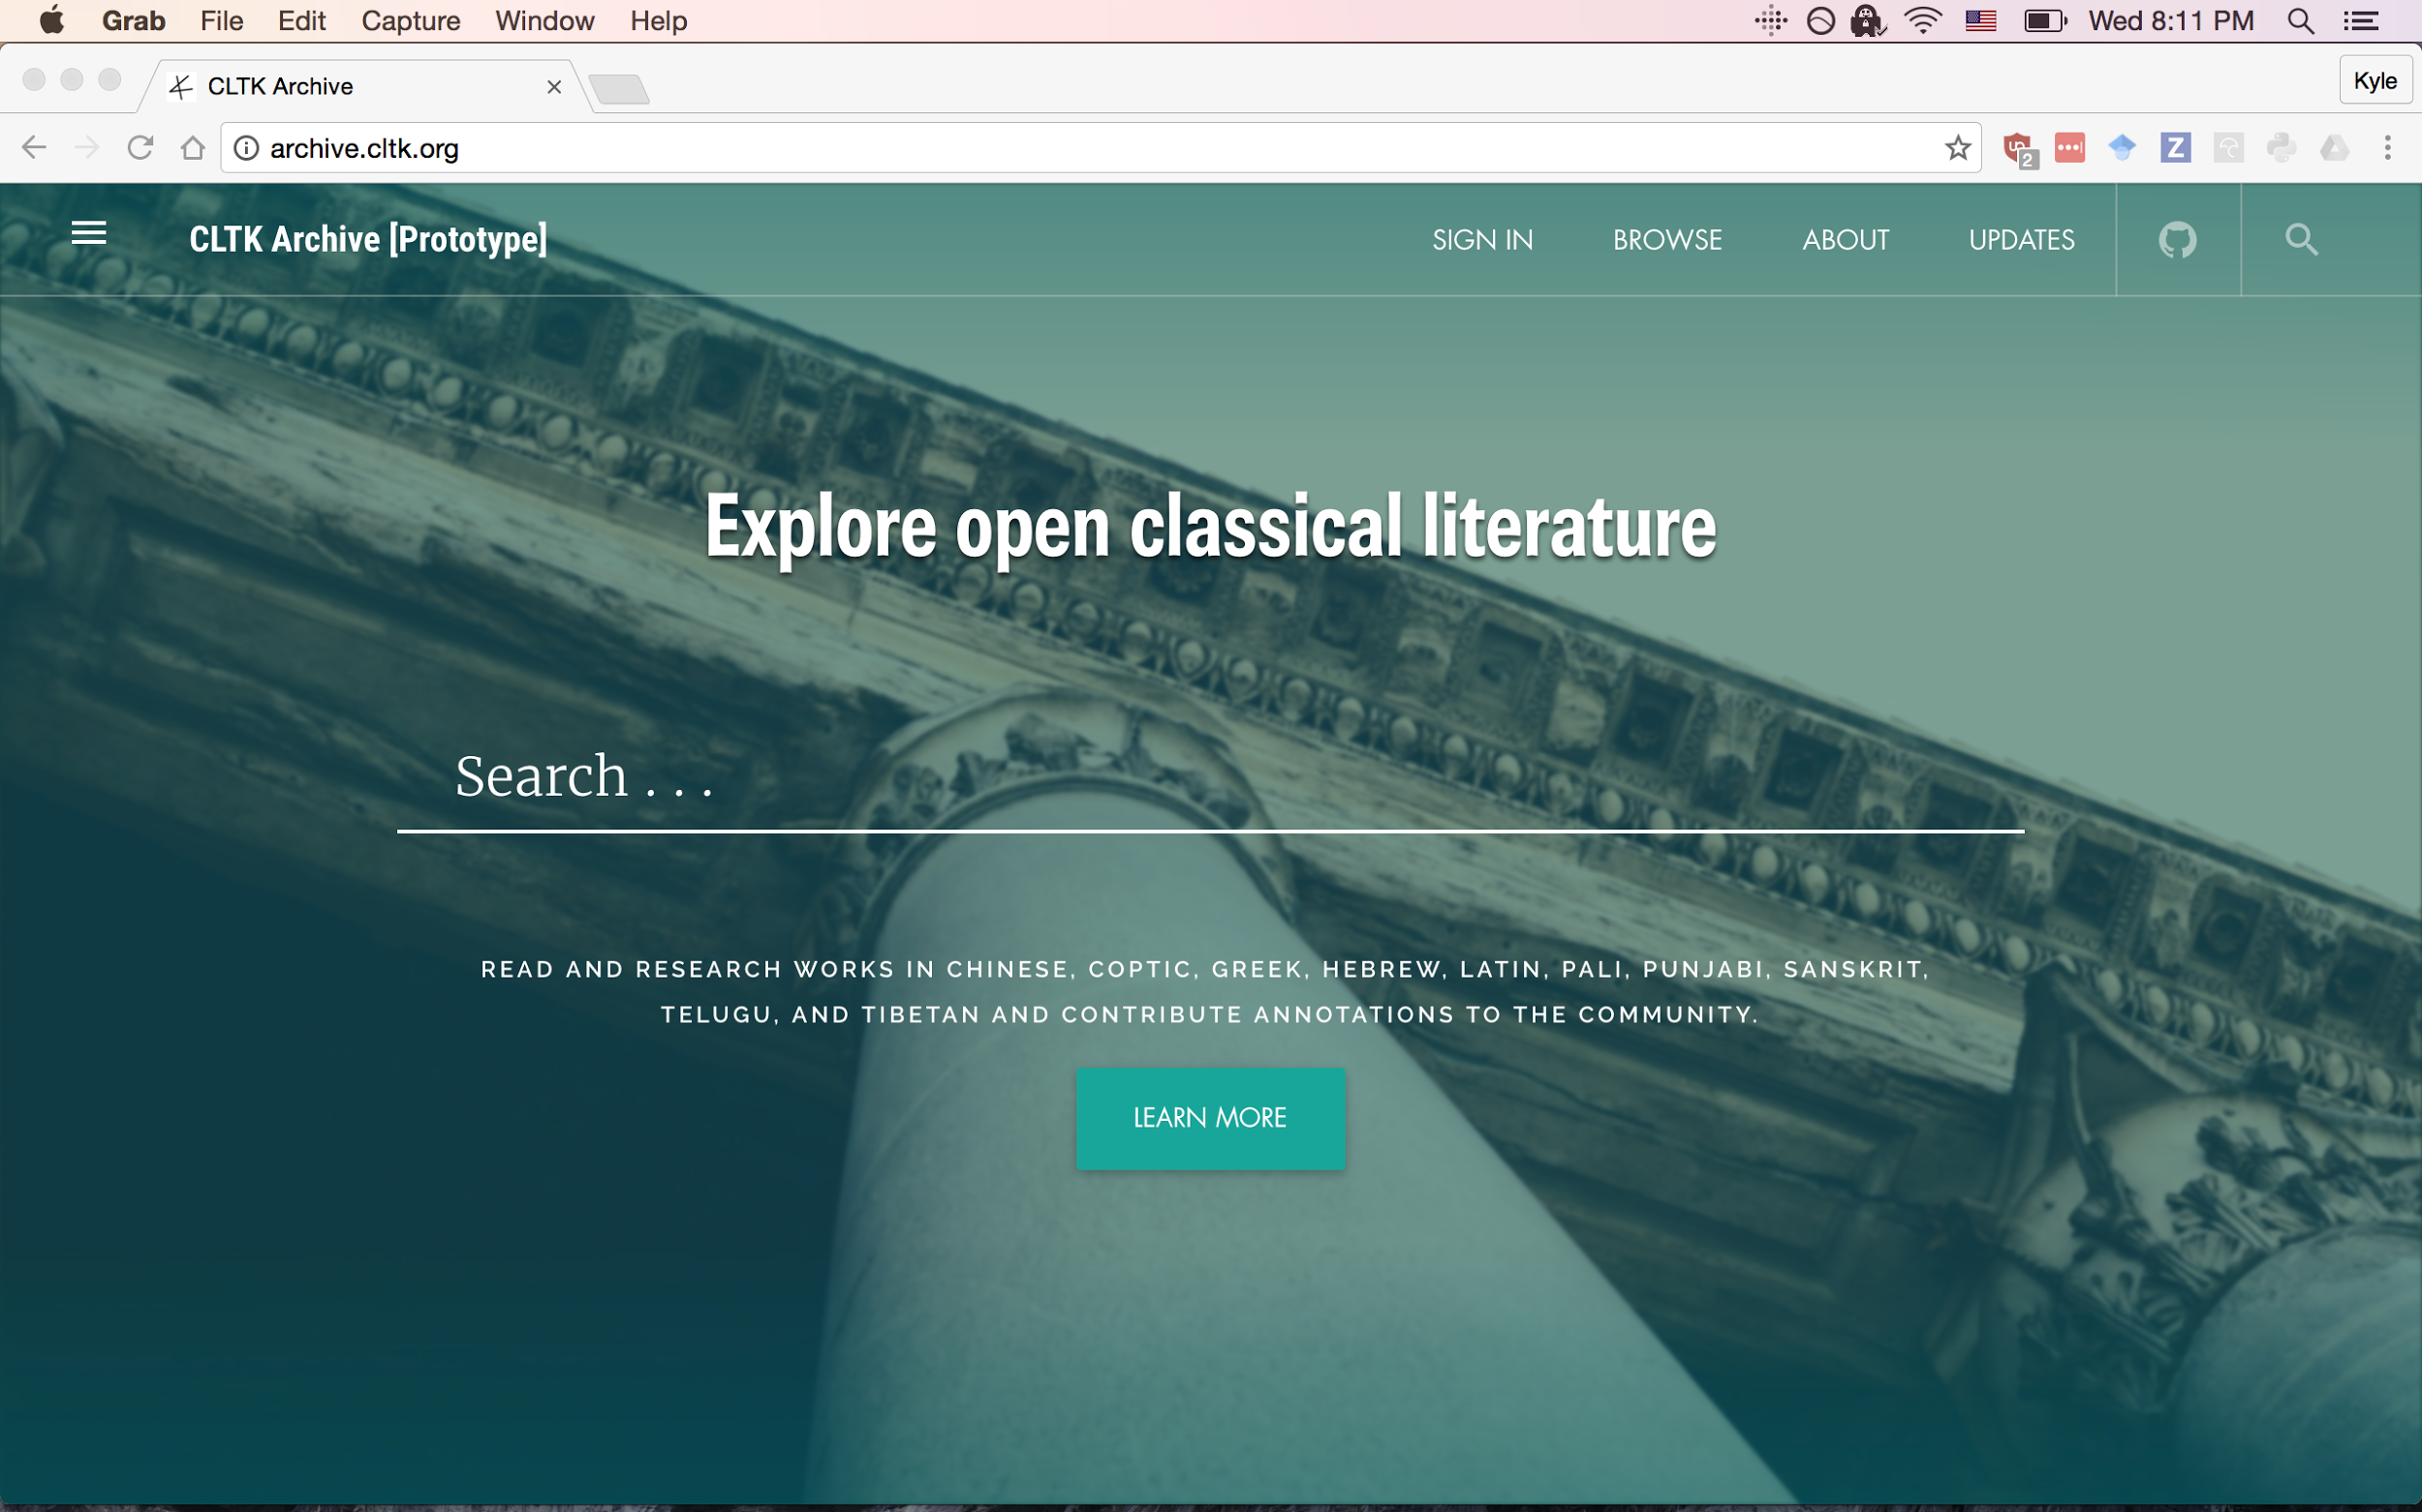
CLTK Archive
http://archive.cltk.org
Almost to “alpha”
Led and designed by Luke Hollis
Node.js + React frontend
Interactive reading, research, and educational environment
Document annotations
Scholarly commentaries
Vocabulary and morphology help
Poetry scansion
Standard document format for adding new languages

Slide 13
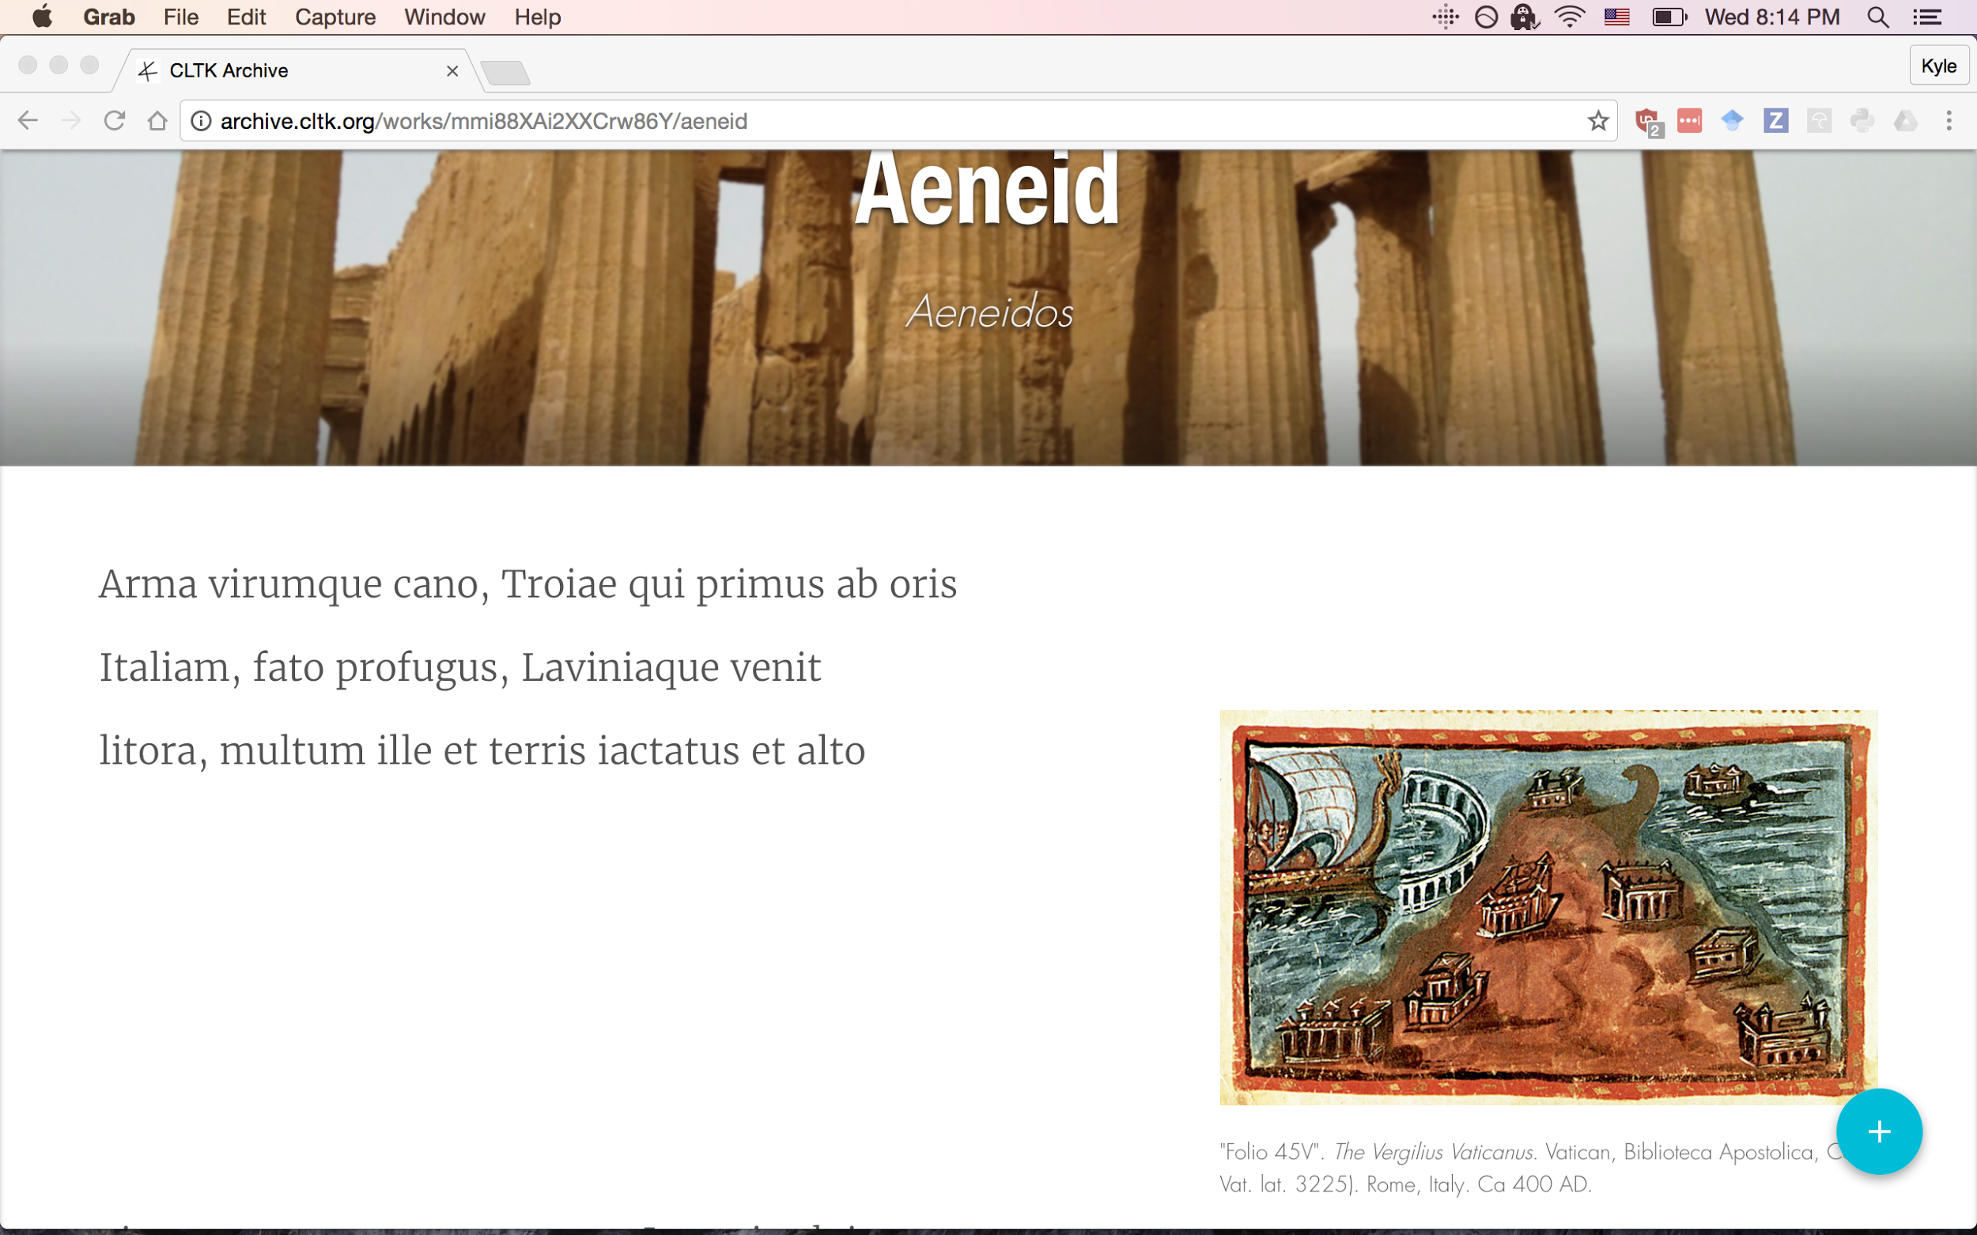

Slide 14
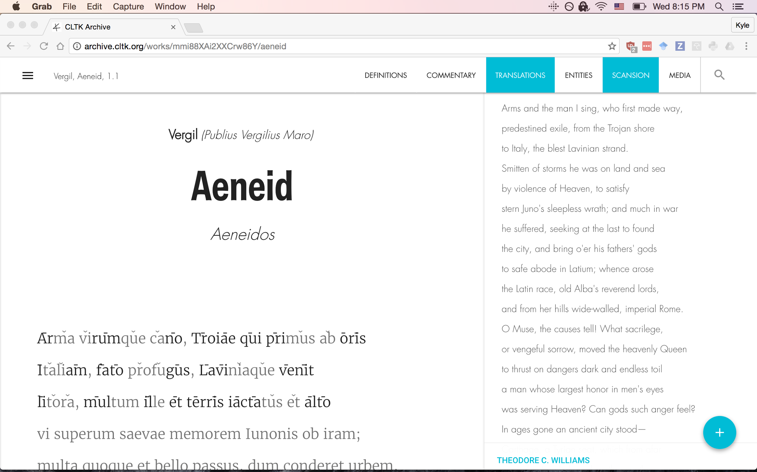

Slide 15
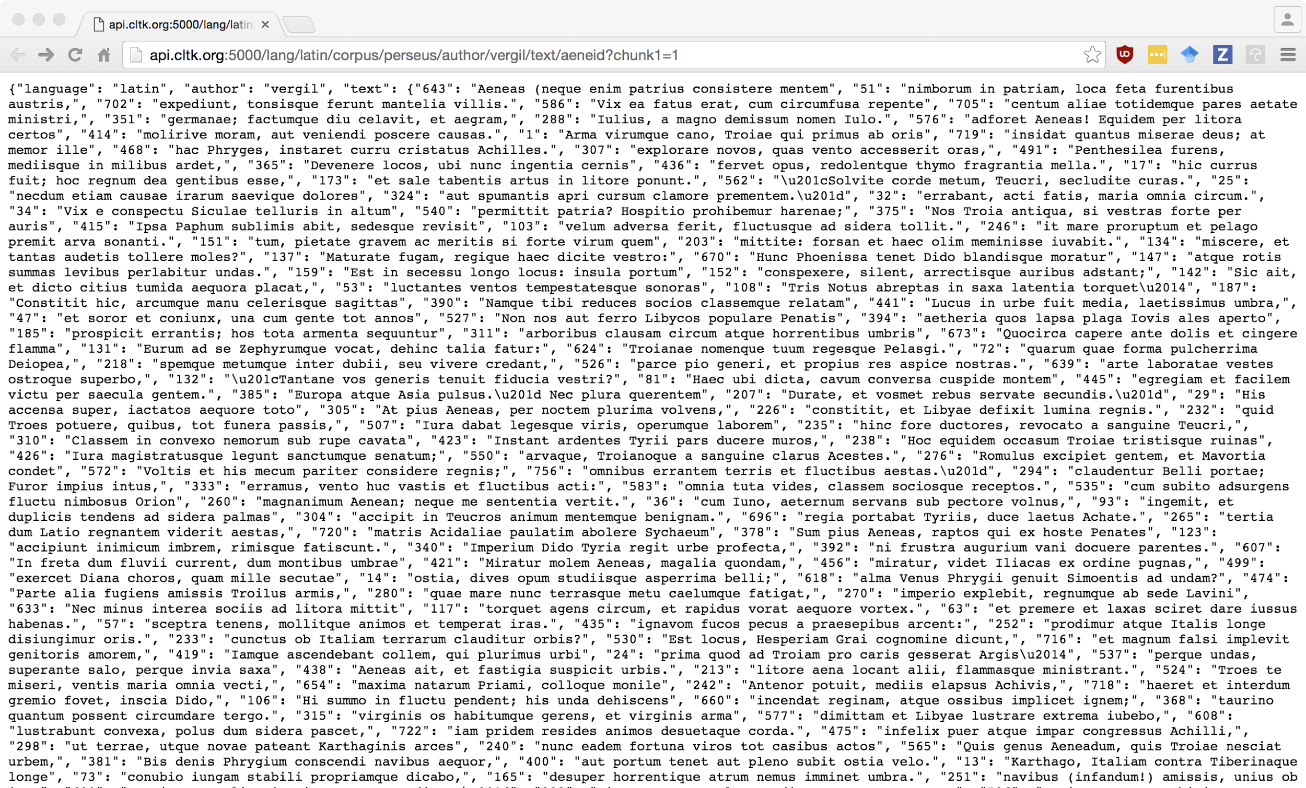
CLTK API
http://api.cltk.org (soon)
Logical text serving
Post data for NLP
RESTful design
Python w/ the Flask framework
Containerized with Docker, served on Google Cloud Platform with Kubernetes

Slide 16
Linked Data Reading Interface for Classical Texts
Leverage metadata to create a multimedia networked reading environment
Digital narrative construction from data journalists
Linked data resources and create our own
Researchers, educators, and students tools that simplify in depth study of classical texts

Slide 17
Current Status
611 classical texts
317,721 nodes
109 authors
5 languages
4,593 definitions for 14,489 word forms
19,892 entities from Wikipedia
~180,000 related passages (above significance threshold)

Slide 18
Reading Environment Metadata
Commentary (modern)
Translations
Definitions
Media (images / manuscripts, audio soon)
Entities (Wikipedia, Pleiades)
Related Passages (text reuse)
Scansion
Annotations
Annotation collection (soon)
Criticism (soon)

Slide 19
Prototype currently accessible
http://archive.cltk.org

Slide 20
User Story: Educator and annotation collections
Educator can
create annotations,
add annotations to a collection,
and share a link to that collection with their classroom

Slide 21
Metadata is not static - deployment with microservices
Metadata is not static - continuously evolving as corpora are added/updated
Moving away from a large application and single point of failure
Packaging data mining scripts as services
Migrating to Google Cloud Platform with Kubernetes

Slide 22
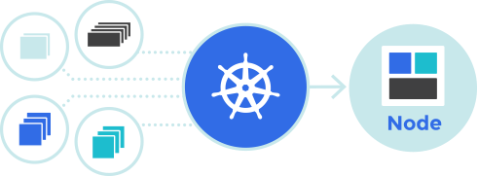
Metadata continually refreshing / evolving
Static JSON files and CLTK text API
Reading environment
Data mining services
Other API responses
Media files

Slide 23



Meteor / Apollo stack / GraphQL

Slide 24
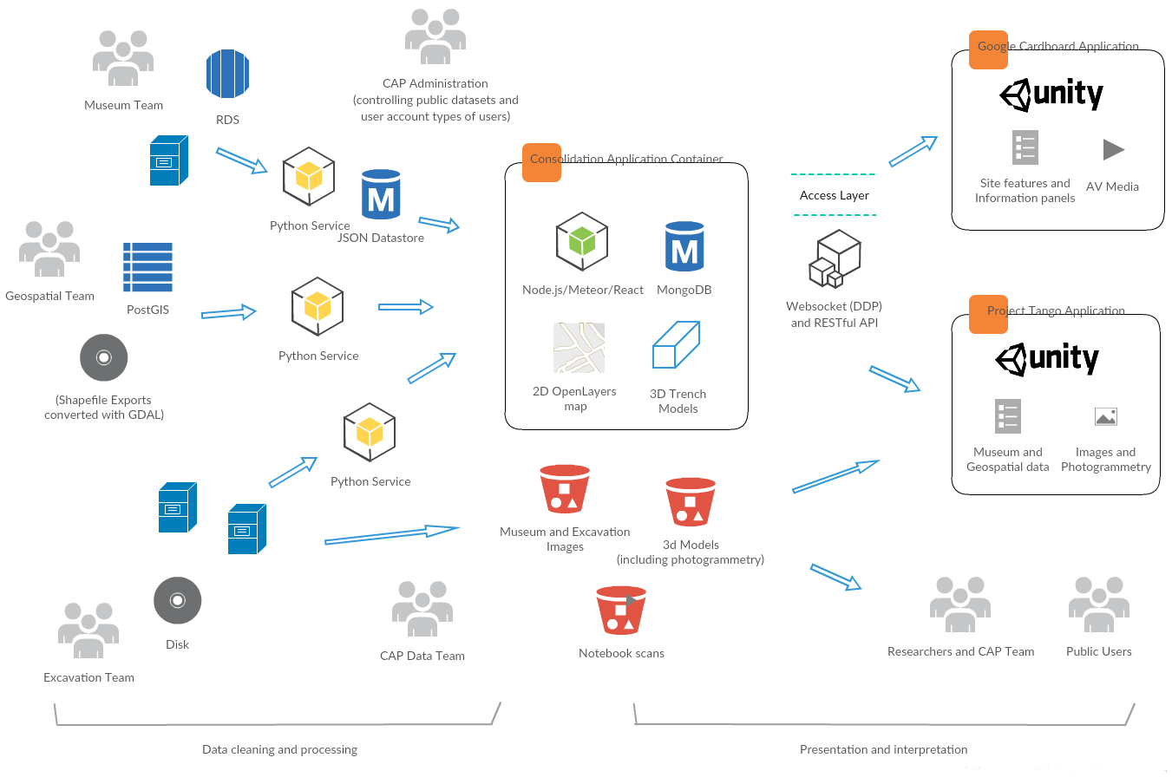
Example application environment

Slide 25
Building content and fixing existing content
Application users:
Media / annotation creation
Exploring options for crowdsourcing correcting or adding the metadata as ‘Community Editors’

Slide 26
Works with any texts in our JSON format
If anyone here has documents they’d like to share in a multimedia, linked data reading environment, you can get started very quickly
{
title: ‘Aeneid’,
texts: {
‘1’: {
‘1’ : ‘Arma virumque cano Troiae qui primus ab oris’,
}
}
}

Slide 27
Workflow: Leveraging CLTK core modules for identifying and extracting metadata
Lemmatization
Named Entity Recognition
Text Reuse

Slide 28
Scientific method and communication
Peer review
Documentation
Reproducibility
Archiving
Data sharing
Make observations
Think of interesting questions
Formulate hypotheses
Develop testable predictions
Gather data to test predictions
Develop general theories
(repeat)

Slide 29
Scientific method and communication
Peer review
Documentation
Reproducibility
Archiving
Data sharing
Make observations
Think of interesting questions
Formulate hypotheses
Develop testable predictions
Gather data to test predictions
Develop general theories
(repeat)

Slide 30
Scientific method and communication
Peer review
Documentation
Reproducibility
Archiving
Data sharing
Make observations
Think of interesting questions
Formulate hypotheses
Develop testable predictions
Gather data to test predictions
Develop general theories
(repeat)
Data sets should be:
Versioned
Author-attributed
Auditable
Editable
Easily obtained

Slide 31
Technical organization: Repositories

Slide 32
Technical organization: Repositories

Slide 33
Technical organization: Core vs. Data
CLTK Core software
Led by programmers
Coordinates data processing
Downloads and installs data repositories
Linguistic data repositories
Led by language experts
Plaintext corpora
Trained models (for machine learning)
Dictionaries, word lists
Tagged texts (for part-of-speech, dependency grammar)
CLTK Archive and API
Reading environment, with NLP and research extras
Totally led by Luke Hollis

Slide 34
(Really quick) quickstart
Make virtualenv and download core
$ pyvenv venv
$ source venv/bin/activate
$ pip install cltk
Download and import corpora
$ python
>>> from cltk.corpus.utils.importer import CorpusImporter
>>> ci = CorpusImporter('greek')
>>> ci.list_corpora
['greek_software_tlgu', 'greek_text_perseus', 'phi7', 'tlg', 'greek_proper_names_cltk', 'greek_models_cltk', 'greek_treebank_perseus', 'greek_lexica_perseus', 'greek_training_set_sentence_cltk', 'greek_word2vec_cltk']
>>> ci.import_corpus('greek_text_perseus')

Slide 35
Setup for PHI and TLG corpora
PHI5, PHI7, and TLG_E
Not downloaded, but imported from local files
>>> ci.import_corpus('tlg', '~/Documents/corpora/TLG_E/')
Makes copy of corpus at ~/cltk_data/originals
Convert TLG from Beta Code into Unicode
>>> from cltk.corpus.greek.tlgu import TLGU
>>> t = TLGU()
>>> t.convert_corpus(corpus='tlg')
>>> t.convert_corpus(corpus='phi5')
Makes copy of corpus in ~cltk_data/greek/text/tlg or ~/cltk_data/latin/text/phi5

Slide 36
NLP for all languages
Concordance
Information retrieval
Plain and regex searching
Robust boolean search on the way
n-gram: 'Ut primum nocte discussa sol’
bigrams: ('ut', 'primum'), ('primum', 'nocte'), ('nocte', 'discussa'), ('discussa', 'sol')
trigrams: ('ut', 'primum', 'nocte'), ('primum', 'nocte', 'discussa'), ('nocte', 'discussa', 'sol')
5-grams: ('ut', 'primum', 'nocte', 'discussa', 'sol')
Word frequencies
simple count for a word
complete reports for a text
Word tokenization (via NLTK)

Slide 37
NLP for Greek and Latin
Text normalization
j → i, v → u (Latin)
Beta Code conversion (for legacy Greek texts)
TLG and PHI corpus specific (remove formatting)
Unicode normalization
Sentence tokenizer
Lemmatizer
Stemmer (Latin)
Word tokenizer, for enclitics (Latin)
Stopword filtering

Slide 38
NLP for Greek and Latin (cont'd.)
Named Entity Recognition (NER)
Part-of-speech (POS) tagger
From Perseus/Alphaeus treebank
Great work remaining to be done, convert their codes to others (Brill, PROIEL, etc)
Dependency grammar tagger # In progress!
Prosody scanner
Syllabifier (Greek)
TLG and PHI5 indices
File to author, genre to authors, date to authors, gender to authors, etc.
Word2Vec

Slide 39
Beyond Greek and Latin
68 repos at https://github.com/cltk
Chinese, Coptic, Pali, Tibetan, Middle English, Telugu, Classical Hindi, Sanskrit, Hebrew, Aramaic, Old & Middle English
2.5 GB (!) of Chinese Buddhist texts
Coptic texts (via Coptic Scriptorium)
Pali Tipitaka
Tibetan POS tagged texts and a lexicon
Parallel corpora – ready for statistical machine translation (hint, hint)
Corpus of ~50 million Hebrew words, ~20 million Aramaic (via Sefaria)
Entirety of Perseus/Open Philology 10s of millions of words

Slide 40
Re-classifying Greek genres

Slide 41
Problem
Genre labels to Greek literature have slowly accumulated over the past 2,500+ years. They do not reflect the thinking of one people or method, but are the result of centuries of consensus and debate.
What is a genre?

Slide 42
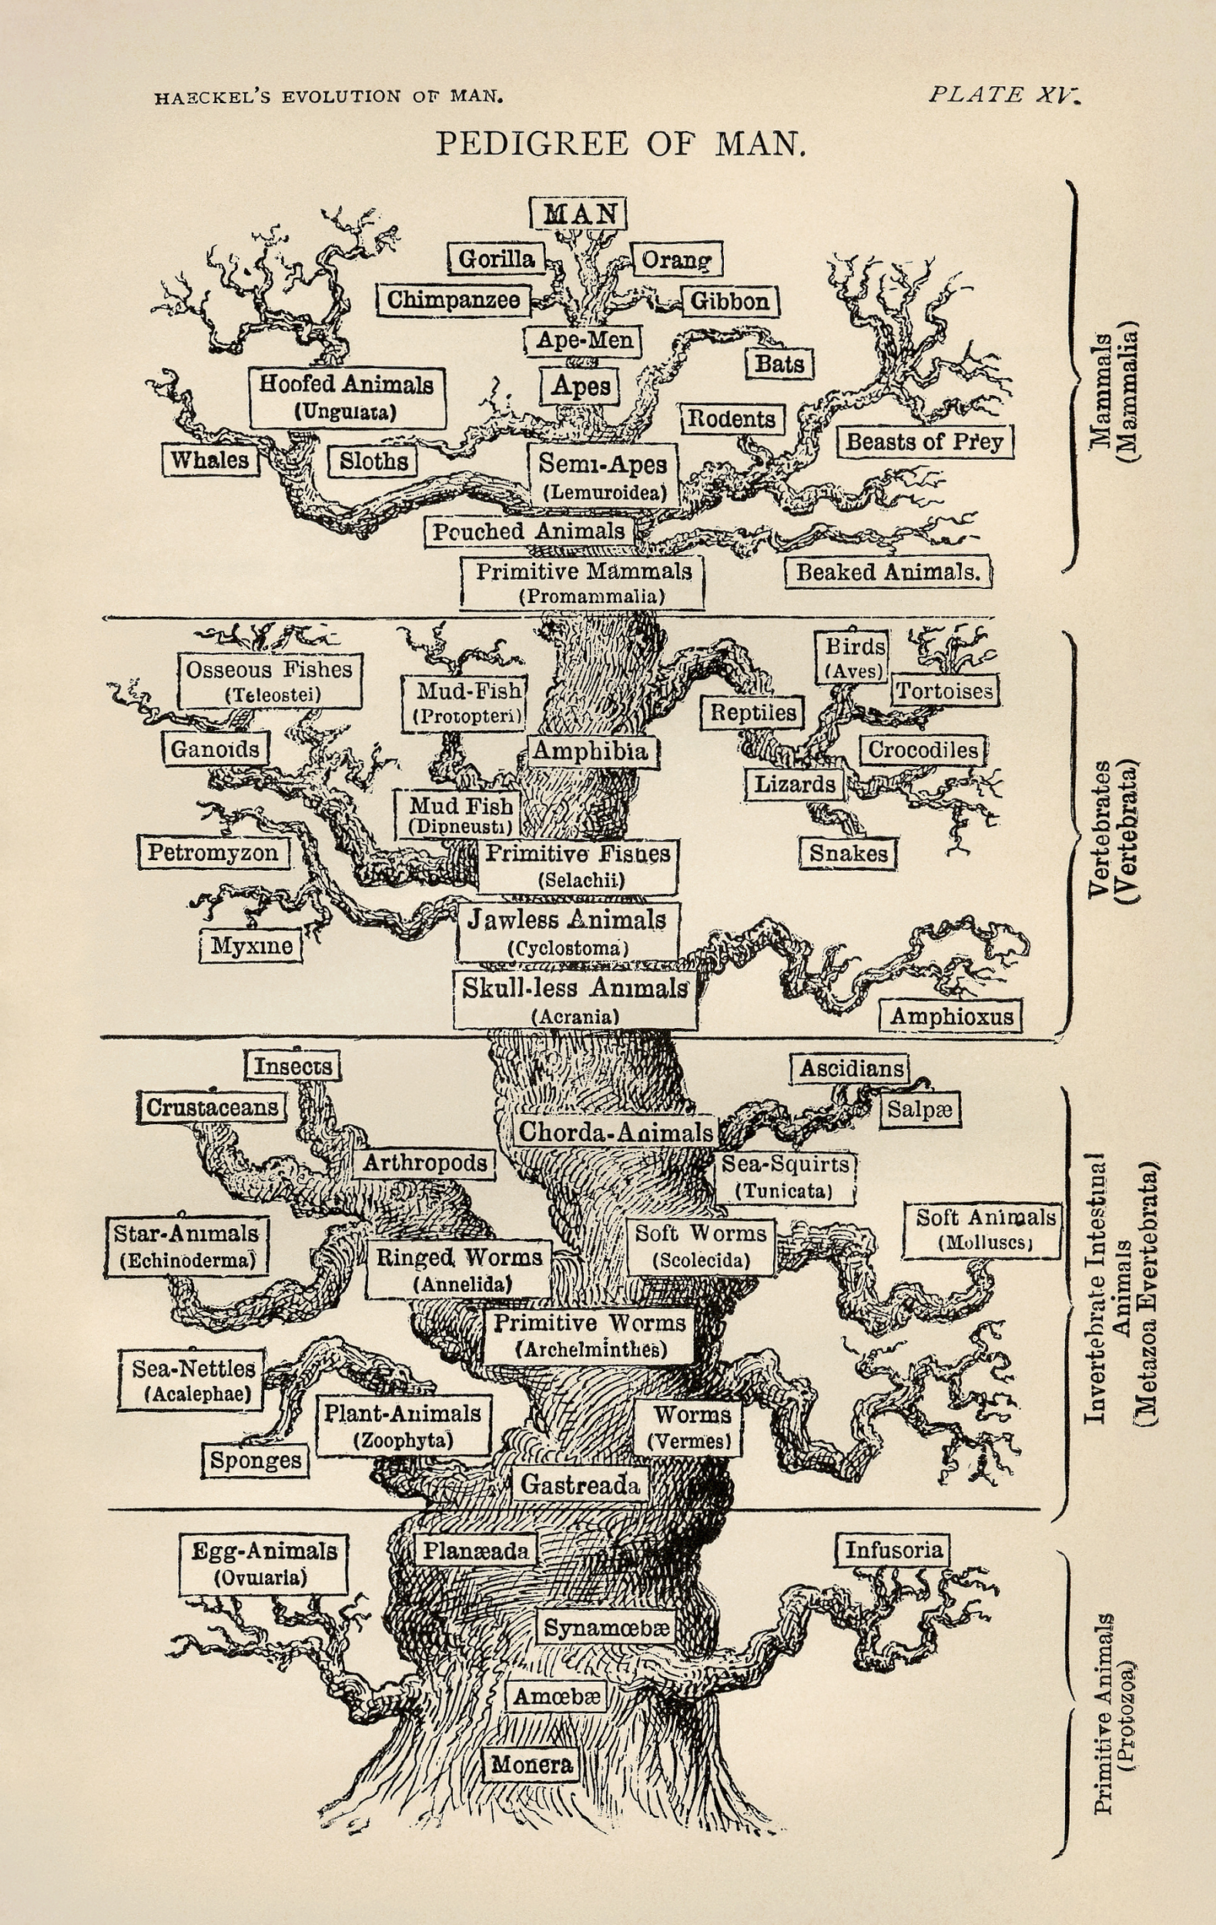
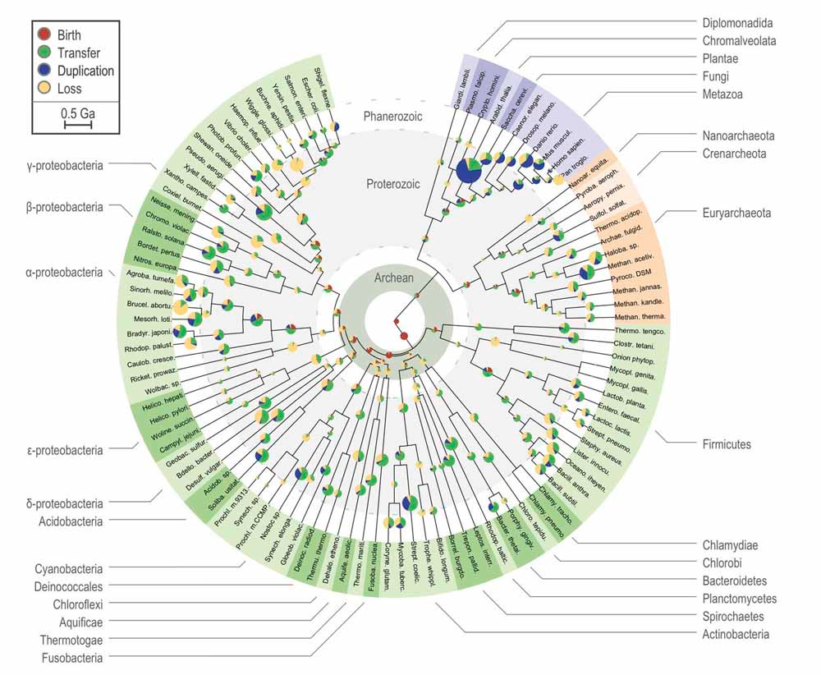
Notes:
Analogy, what are the different types of trees? It’s as if we used Linneaus’s categories, even though DNA sequencing tells us otherwise.
Ernst Haeckel: https://upload.wikimedia.org/wikipedia/commons/d/de/Tree_of_life_by_Haeckel.jpg
http://www.gridgit.com/postpic/2015/04/tree-life-evolution-chart_290093.jpg

Slide 43
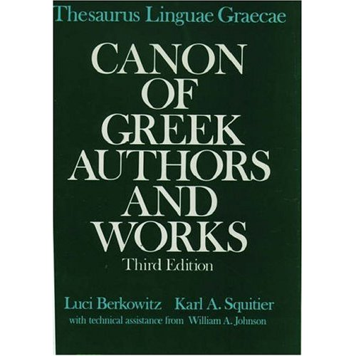
?
Notes:
By analogy, we have not updated our taxonomy of ancient literature by statistical means.
https://images-eu.ssl-images-amazon.com/images/I/51T04RR80HL._SS500_.jpg

Slide 44
Hypothesis
Can statistical machine learning both expose illogical elements of the traditional taxonomy and also assist in creating a new data–driven one?
Can AI classify literature better than the scholarly tradition?
Notes:
Pose as a question

Slide 45
Methodology
Let’s look at what text data survives, its basic linguistic properties, how well it clusters in unsupervised ML, and how supervised models perform with various features extracted.
Discovery, clustering, & classification
Notes:
Lexical diversity; topic modeling; ML classification; DL classification
• See the other TLG book (covering only through 6th century AD) which says there were 2,900 authors with 8,000 individual works
Luci Berkowitz, Karl A. Squitier, William Allen Johnson, Oxford University Press, 1986
https://books.google.com/books?id=X8JHAAAAMAAJ&dq=thesaurus+linguae+graecae&hl=en&sa=X&ved=0ahUKEwj6uPLA6OjPAhUO24MKHTXkAZ0Q6AEIJjAB

Slide 46
Basic corpus statistics
Corpus counts
Counts per author
Avgs per author
Total author files: 1,822
Total words: 72,057,716
Total unique words: 1,515,193
Mean words per author: 39526.99725726824
Standard deviation of words per author: 174923.28976653758
Mean unique words per author: 5435.820076796489
Standard deviation of unique words per author: 14195.290142159112
Notes:
Mean words per author: 39526.99725726824 Standard deviation of words per author: 174923.28976653758 Mean unique words per author: 5435.820076796489 Standard deviation of unique words per author: 14195.290142159112

Slide 47
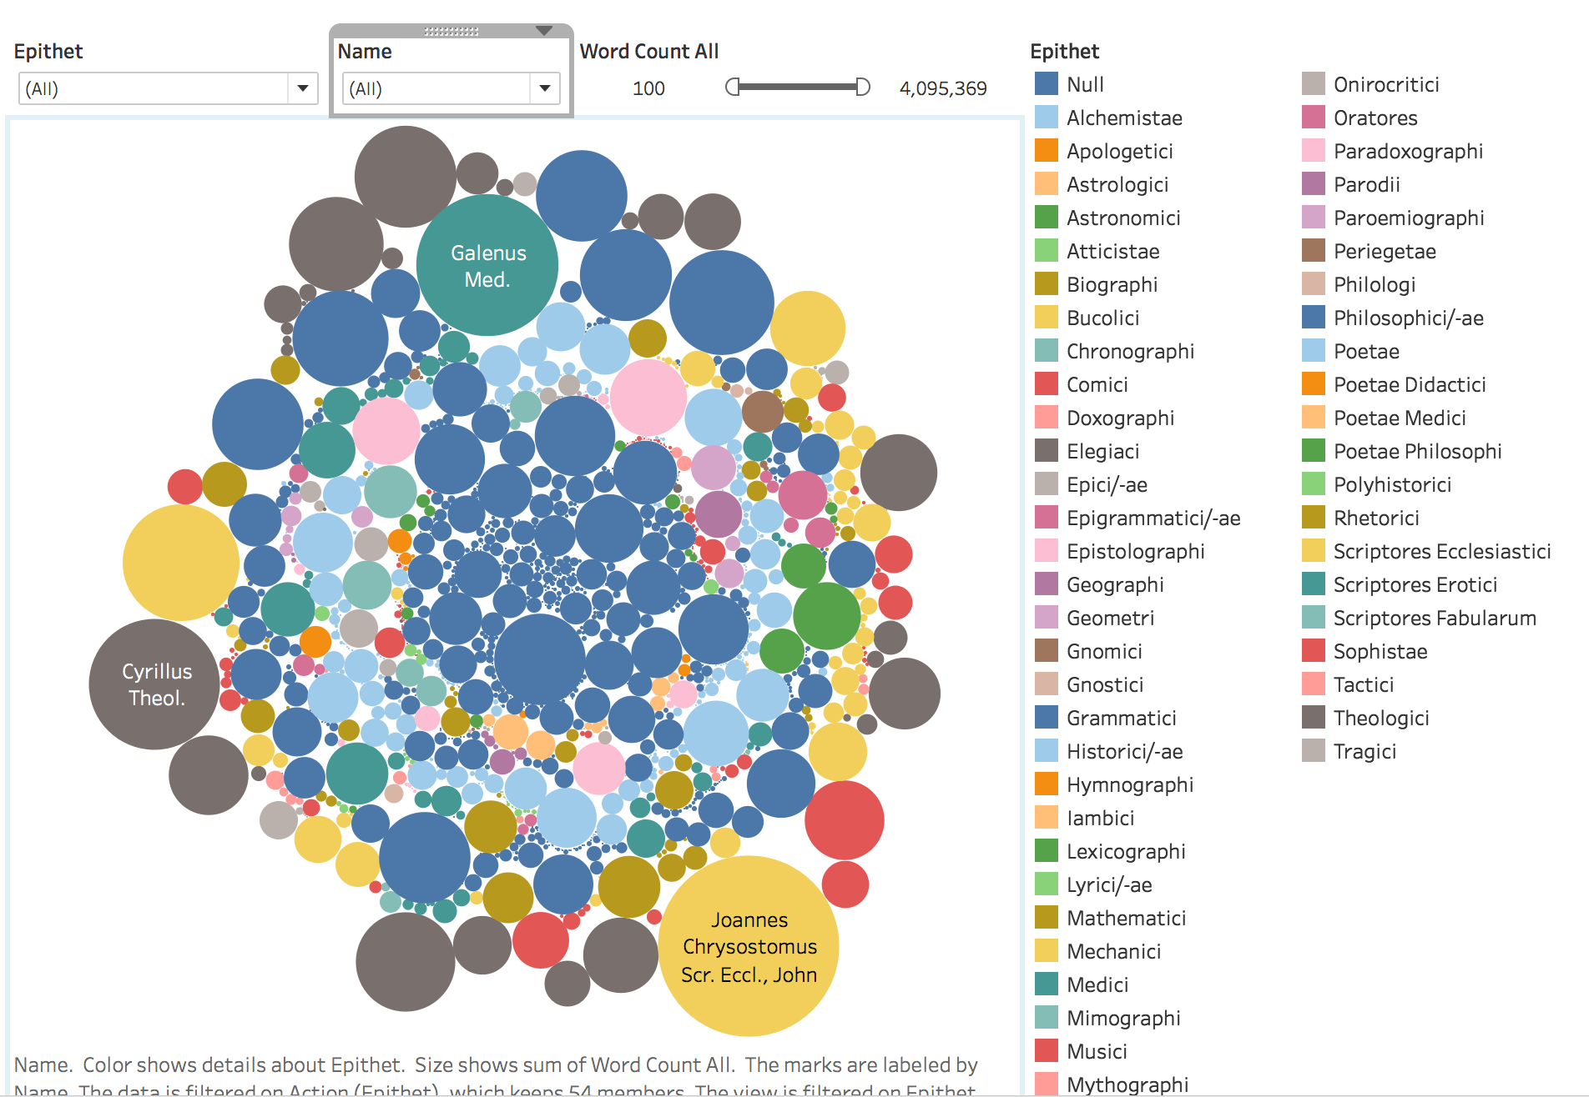
Authors by surviving text

Slide 48
Basic corpus statistics
Lexical diversity
Lexical diversity per author: 0.5171187962883808
Standard deviation of lexical diversity per author: 0.2732410961564417
Notes:
Mean words per author: 39526.99725726824 Standard deviation of words per author: 174923.28976653758 Mean unique words per author: 5435.820076796489 Standard deviation of unique words per author: 14195.290142159112

Slide 49
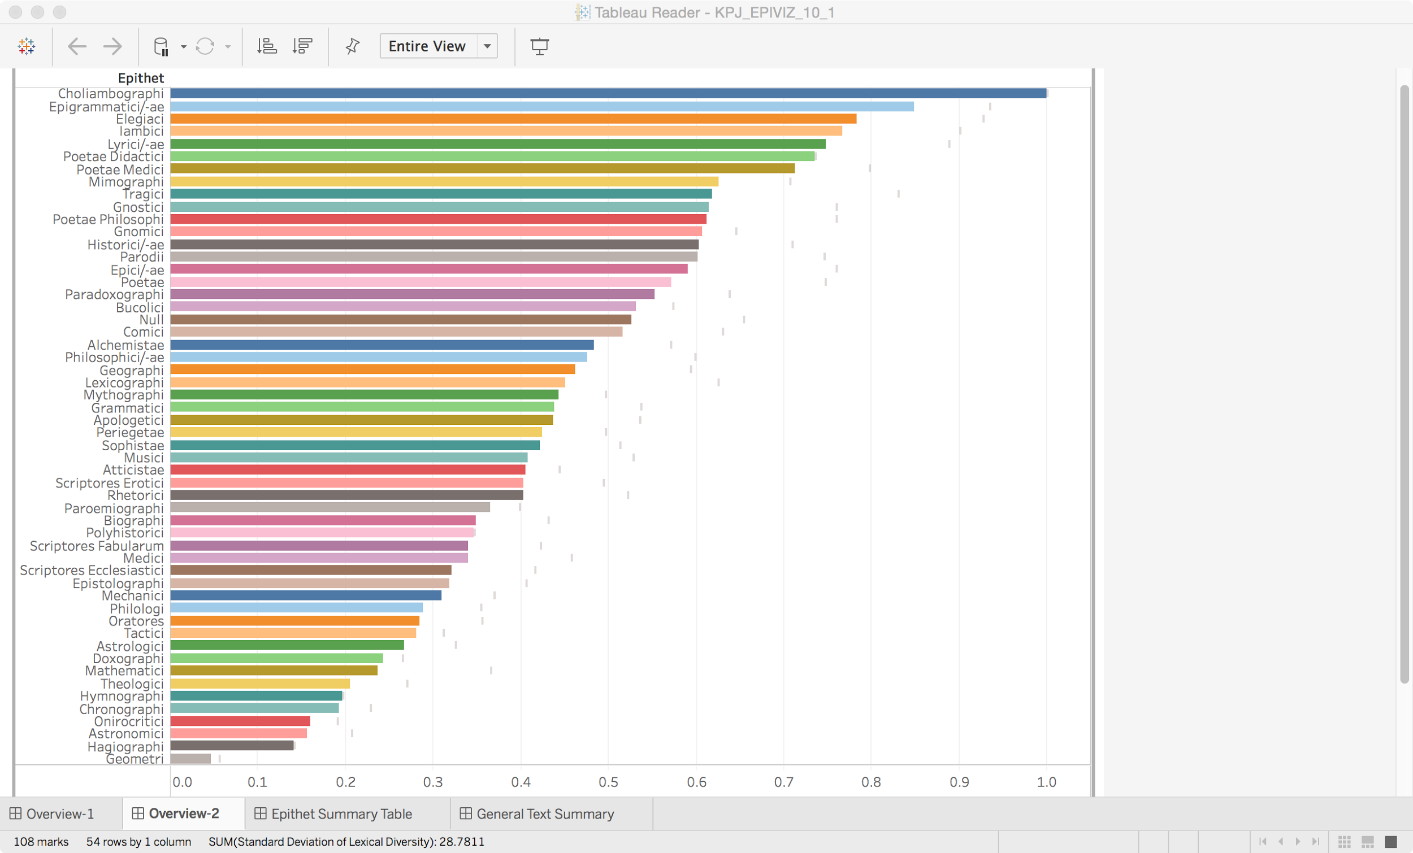
Genres by average lexical diversity

Slide 50
Genre stats
Overall
Highest lex. diversity
Lowest lex. diversity
Labels: 56 (including “no label”)
Choliambographi, 1.0
Epigrammatici, 0.886
Elegiaci, 0.789
Lyrici, 0.750
Iambici, 0.748
Poetae Didactici, 0.735
Geometri, 0.046
Scriptores Rerum Naturalium, 0.151
Onirocritici, 0.160
Chronographi, 0.192
Hymnographi, 0.120
Theologici, 0.206
Astronomici, 0.211
Mathematici, 0.226
Doxographi, 0.243
Notes:
https://github.com/kylepjohnson/notebooks/tree/master/public_talks/2016_10_26_harvard

Slide 51
Genre stats
Philosophici
Historici
Mechanici
Lex. diversity: 0.472702
Mean wc/author: 51,513
Mean unique wc/author: 5,177
Lex. diversity: 0.598809
Mean wc/author: 20,618
Mean unique wc/author: 3,570
Lex. diversity: 0.310574
Mean wc/author: 24,746
Mean unique wc/author: 3,331
Notes:
https://github.com/kylepjohnson/notebooks/tree/master/public_talks/2016_10_26_harvard

Slide 52
Clustering
NMF (similar to LDA)
Topic–to–epithets
Under 20% diversity: Theologici, Historici/-ae, Philosophici/-ae, Scriptores Ecclesiastici
Epithet–to–topics
Under 20% diversity:
0: Philosophici/-ae
1: Historici/-ae
2: Comici
3: Scriptores Ecclesiastici
4: Historici/-ae
Affinity Clustering
Problem: Clusters very tight
Notes:
https://138.68.43.124:9999/notebooks/2.2b%20Clustering%20(w%20doc%20reduction).ipynb

Slide 53
 | epithet | most_common_topic | topic_diversity | total_docs | unique_topics
0 | Lyrici/-ae | 24 | 0.466667 | 30 | 14
1 | Theologici | 3 | 0.111111 | 36 | 4
2 | Scriptores Fabularum | 0 | 1 | 2 | 2
3 | Atticistae | 17 | 0.75 | 4 | 3
4 | Elegiaci | 24 | 0.5 | 16 | 8
5 | Sophistae | 0 | 0.307692 | 39 | 12
6 | Medici | 5 | 0.302326 | 43 | 13
7 | Philosophici/-ae | 0 | 0.172775 | 191 | 33
8 | Polyhistorici | 6 | 1 | 1 | 1
9 | Apologetici | 3 | 0.444444 | 9 | 4
10 | Mimographi | 2 | 0.5 | 2 | 1
11 | Hymnographi | 3 | 1 | 1 | 1
12 | Biographi | 3 | 0.666667 | 9 | 6
13 | Poetae | 4 | 0.421053 | 19 | 8
14 | Gnomici | 50 | 1 | 4 | 4
15 | Mathematici | 10 | 0.555556 | 9 | 5
Topics w/in epithets
Notes:
https://docs.google.com/spreadsheets/d/1FQd1W4RuEvpkWaBCvMFBQLkOycMgZPts9wjOWElyRVk/edit#gid=660118713

Slide 54
 | epithet_diversity | most_common_epithet | topic | total_epithets | unique_epithets
0 | 0.15 | Philosophici/-ae | 0 | 220 | 33
1 | 0.155172 | Historici/-ae | 1 | 58 | 9
2 | 0.195122 | Comici | 2 | 82 | 16
3 | 0.15 | Scriptores Ecclesiastici | 3 | 80 | 12
4 | 0.19802 | Historici/-ae | 4 | 101 | 20
5 | 0.25 | Medici | 5 | 24 | 6
6 | 0.307692 | Historici/-ae | 6 | 26 | 8
7 | 0.375 | Historici/-ae | 7 | 8 | 3
8 | 0.5 | Grammatici | 8 | 8 | 4
9 | 0.466667 | Comici | 9 | 15 | 7
10 | 0.45 | Mathematici | 10 | 20 | 9
11 | 0.545455 | Historici/-ae | 11 | 11 | 6
12 | 0.1875 | Historici/-ae | 12 | 16 | 3
13 | 0.833333 | Philosophici/-ae | 13 | 6 | 5
Epithets w/in topic
Notes:
https://docs.google.com/spreadsheets/d/1FQd1W4RuEvpkWaBCvMFBQLkOycMgZPts9wjOWElyRVk/edit#gid=643886554

Slide 55
Most consistent topics
0: Philosophici/-ae
ειμι 2.85 | ου 1.01 | εχω 0.95 | τος 0.49 | ποιεω 0.47 | πα 0.37 | οιος 0.36 | τοιου 0.36 | αυτο 0.36 | μονον 0.35 | ολοξ 0.34 | δεω1 0.34 | ος 0.32 | μαλλον 0.31 | φημι 0.31 | ειπον 0.31 | παλιν 0.31 | παντα 0.3 | εαυτου 0.3 | κατ 0.28 |
1: Historici/-ae
φημι 3.03 | ειμι 0.69 | φησι 0.41 | φησιν 0.36 | λεγει 0.3 | πρωτω 0.27 | γενεσθαι 0.27 | ιστορεω 0.22 | φασι 0.21 | καθα 0.21 | προτερος 0.2 | καλεω 0.19 | διος 0.17 | λεγεται 0.17 | υστερος 0.16 | αθηνη 0.16 | ιερον 0.15 | γουν 0.15 | διο 0.14 | λεγεσθαι 0.14 |
2: Comici
ειμι 0.64 | κακοω 0.51 | ανηρ 0.39 | οραω 0.38 | ευ 0.33 | δοκεω 0.32 | κακον 0.31 | εχω 0.29 | απας 0.29 | ζαω 0.28 | ειδον 0.26 | εμεω 0.26 | αγαθος 0.25 | ποτ 0.23 | αει 0.22 | καλος 0.21 | νυ 0.21 | βιον 0.21 | οιδα 0.21 | καν 0.2 |
Notes:
These are the 5 lowest diversity of epithet w/in topic

Slide 56
Most consistent topics
3: Scriptores Ecclesiastici
χριστος 0.97 | θεαομαι 0.83 | θεος 0.48 | κυριου 0.4 | ιησου 0.4 | κυριος 0.37 | θεον 0.32 | ου 0.28 | χριστον 0.28 | αγιος 0.28 | υιος 0.27 | ανθρωπος 0.22 | μα 0.22 | πνευ 0.21 | λεγει 0.2 | προφητης 0.19 | ειμι 0.18 | πνευματος 0.18 | αγιου 0.18 | σωτηρ 0.17 |
4: Historici/-ae
πολιν 0.53 | πολεως 0.5 | εκει 0.46 | πολυς 0.38 | εχω 0.38 | ανηρ 0.31 | ου 0.3 | εαυτου 0.28 | βασιλεως 0.28 | ειμι 0.28 | νος 0.27 | πολεμον 0.26 | ηδος 0.24 | αρχω 0.24 | πολει 0.23 | χωραν 0.22 | ταυτην 0.21 | εκεινου 0.21 | θεν 0.21 | απας 0.2 |
Notes:
These are the 5 lowest diversity of epithet w/in topic

Slide 57
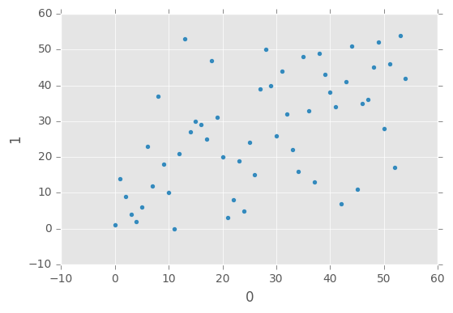
Classification
Decision tree
Random forest
ADA boost
CNN
Binary, Philosophy and Theology
acc 0.609023
https://github.com/kylepjohnson/cnn-text-classification-tf
TODO
LDA-HDP

Slide 58
Feature extraction (tf-idf)
 | ααω | αβαθης | … | αβακιον | ϲωμα | ϲωμαϲιν | epithet
0 | 0 | 0 |  | 0 | 234 | 1459 | Historici/-ae
1 | 0 | 0 |  | 0 | 23 | 825 | Tragici
2 | 0 | 0 |  | 0 | 323 | 331 | Tragici
3 | 0 | 0 |  | 0 | 66 | 417 | Comici
6 | 0 | 0 |  | 0 | 98 | 2475 | Historici/-ae
7 | 0 | 0 |  | 0 | 638 | 4075 | Philosophici/-ae
8 | 0 | 0 |  | 0 | 2 | 2127 | Sophistae
9 | 1 | 0 |  | 0 | 0 | 2074 | Theologici
10 | 0 | 0 |  | 0 | 45 | 2173 | Historici/-ae
11 | 0 | 0 |  | 0 | 3 | 1419 | Scriptores

Slide 59
Feature extraction (morphology)
 | verb | noun | … | participle | adjective | adverb | epithet
0 | 2466 | 5367 |  | 1445 | 2342 | 1459 | Historici/-ae
1 | 2256 | 3460 |  | 2332 | 2089 | 825 | Tragici
2 | 906 | 1568 |  | 736 | 842 | 331 | Tragici
3 | 44 | 99 |  | 34 | 20 | 417 | Comici
6 | 679 | 2001 |  | 209 | 309 | 2475 | Historici/-ae
7 | 35 | 55 |  | 27 | 12 | 4075 | Philosophici/-ae
8 | 89 | 85 |  | 70 | 36 | 2127 | Sophistae
9 | 44 | 53 |  | 38 | 0 | 2074 | Theologici
10 | 908 | 1378 |  | 798 | 198 | 2173 | Historici/-ae
11 | 66 | 87 |  | 63 | 45 | 1419 | Scriptores

Slide 60
Feature extraction (syntax)
 | nsubj | det | … | amod | nmod | dobj | epithet
0 | 353 | 337 |  | 910 | 346 | 405 | Historici/-ae
1 | 2323 | 4129 |  | 292 | 335 | 918 | Tragici
2 | 233 | 678 |  | 383 | 232 | 248 | Tragici
3 | 44 | 35 |  | 23 | 39 | 32 | Comici
6 | 434 | 564 |  | 234 | 203 | 234 | Historici/-ae
7 | 7 | 24 |  | 2 | 13 | 234 | Philosophici/-ae
8 | 74 | 643 |  | 34 | 44 | 32 | Sophistae
9 | 44 | 55 |  | 53 | 72 | 37 | Theologici
10 | 97 | 10 |  | 344 | 234 | 126 | Historici/-ae
11 | 92 | 322 |  | 63 | 27 | 80 | Scriptores

Slide 61
Epithet | precision | recall | f1-score | support
Alchemistae | 1 | 0.14 | 0.25 | 7
Comici | 0.68 | 0.51 | 0.58 | 51
Elegiaci | 0 | 0 | 0 | 8
Epici/-ae | 0.29 | 0.11 | 0.15 | 19
Grammatici | 0.4 | 0.2 | 0.27 | 20
Historici/-ae | 0.66 | 0.75 | 0.7 | 84
Lyrici/-ae | 0.29 | 0.17 | 0.21 | 12
Medici | 0.15 | 0.29 | 0.2 | 7
Philosophici/-ae | 0.45 | 0.48 | 0.46 | 46
Poetae | 0 | 0 | 0 | 7
Rhetorici | 0.38 | 0.25 | 0.3 | 12
Scriptores Ecclesiastici | 0.44 | 0.31 | 0.36 | 13
Sophistae | 0.33 | 0.25 | 0.29 | 8
Theologici | 0.25 | 0.4 | 0.31 | 5
Tragici | 0.15 | 0.6 | 0.24 | 15
avg / total | 0.49 | 0.45 | 0.45 | 314
Decision tree

Slide 62
Epithet | precision | recall | f1-score | support
Alchemistae | 0 | 0 | 0 | 7
Comici | 0.82 | 0.63 | 0.71 | 51
Elegiaci | 0 | 0 | 0 | 8
Epici/-ae | 0.4 | 0.11 | 0.17 | 19
Grammatici | 0.75 | 0.15 | 0.25 | 20
Historici/-ae | 0.59 | 0.89 | 0.71 | 84
Lyrici/-ae | 0 | 0 | 0 | 12
Medici | 1 | 0.29 | 0.44 | 7
Philosophici/-ae | 0.47 | 0.74 | 0.58 | 46
Poetae | 0 | 0 | 0 | 7
Rhetorici | 1 | 0.17 | 0.29 | 12
Scriptores Ecclesiastici | 0.5 | 0.38 | 0.43 | 13
Sophistae | 0 | 0 | 0 | 8
Theologici | 0 | 0 | 0 | 5
Tragici | 0.22 | 0.73 | 0.34 | 15
avg / total | 0.52 | 0.53 | 0.47 | 314
Random forest

Slide 63
Epithet | precision | recall | f1-score | support
Alchemistae | 1 | 0.29 | 0.44 | 7
Comici | 0.34 | 0.78 | 0.48 | 51
Elegiaci | 0 | 0 | 0 | 8
Epici/-ae | 0 | 0 | 0 | 19
Grammatici | 0.4 | 0.1 | 0.16 | 20
Historici/-ae | 0.6 | 0.58 | 0.59 | 84
Lyrici/-ae | 0 | 0 | 0 | 12
Medici | 0.17 | 0.14 | 0.15 | 7
Philosophici/-ae | 0.3 | 0.54 | 0.39 | 46
Poetae | 0 | 0 | 0 | 7
Rhetorici | 0 | 0 | 0 | 12
Scriptores Ecclesiastici | 0.5 | 0.31 | 0.38 | 13
Sophistae | 0 | 0 | 0 | 8
Theologici | 0.25 | 0.2 | 0.22 | 5
Tragici | 0 | 0 | 0 | 15
avg / total | 0.34 | 0.39 | 0.34 | 314
ADA Boost

Slide 64
Classification results
Overall Random Forest has slight edge over Decision tree
0.1 - 0.3 better in precsion and recall
ADA Boost worst
Interesting:
Alchemistae is 100% precision w/ DT, 0% RF
RF worse precision:: Alchemistae, Historici, Lyrici, Sophistae, Theologici
Medici is 15% precision w/ DT, 100% RF
Rhetorici is 38% precision w/ DT, 100% RF
Elegiaci, Poetae 0% in all
 | precision | recall | f1-score
Decision tree | 0.49 | 0.45 | 0.45
Random forest | 0.52 | 0.53 | 0.47
ADA Boost | 0.34 | 0.39 | 0.34
Notes:
Worse recall also following worse precision
DT seems to have consolidated/generalized small but distinct genres to get
F1 = 2 * ((prec * recall) / (prec + recall))

Slide 65
Preliminary observations
Corpus
Clustering
Classification
Needs aggressive cleanup: lemmatization, stopword rm, and rm short docs
But all should be tested w/o cleanup
“None” docs need a label
Traditional topics show poor consistency with lexical BOW classification
Some noteworthy commonalities
Need more than lexical features
Experiment w/ K
Lexical features perform so-so for predictive modeling
Certain algos perform far better for subsets of data (b/c of their size or uniqueness?)
Candidate for ensemble learning

Slide 66
Conclusion
Socrates on literature vs. reality: “Mimetic art is far removed from truth, and this … is the reason why it can produce everything, because it touches or lays hold of only a small part of the object and that a phantom.” (Plato, Republic X, 598b)
Genres labels might be phantoms
Notes:
πόρρω ἄρα που τοῦ ἀληθοῦς ἡ μιμητική ἐστιν καί, ὡς ἔοικεν, διὰ τοῦτο πάντα ἀπεργάζεται, ὅτι σμικρόν τι ἑκάστου ἐφάπτεται, καὶ τοῦτο εἴδωλον.

Slide 67
Resources
This and other lectures
Core software: https://github.com/cltk/cltk
Bug tracking: https://github.com/cltk/cltk/issues
Beginners’ issues labeled easy
Project repositories: https://github.com/cltk
Docs: http://docs.cltk.org
Installation: http://docs.cltk.org/en/latest/installation.html
Python + Command line basics
Intro to the command line: http://blog.teamtreehouse.com/introduction-to-the-mac-os-x-command-line
Python installation: https://www.python.org/downloads (choose 3.5)
Good self-paced Python lessons: http://learnpythonthehardway.org

Slide 68
Contribute & contact
Classical Language Toolkit
Home: http://cltk.org
Docs: http://docs.cltk.org/en/latest
Source: https://github.com/cltk/cltk
Corpora: https://github.com/cltk
Import module: https://github.com/cltk/cltk/blob/master/cltk/corpus/utils/importer.py
Contribute
Issue tracking: https://github.com/cltk/cltk/issues
Other questions: kyle@kyle-p-johnson.com

Slide 69
Sources
Images
https://s-media-cache-ak0.pinimg.com/originals/61/b2/34/61b23411d0990a69b32a89fba0536cd3.jpg
Git
GitPython: https://github.com/gitpython-developers/GitPython
https://en.wikipedia.org/wiki/Git_(software)
Science
https://en.wikipedia.org/wiki/Scientific_method
https://en.wikipedia.org/wiki/Reproducibility

